Slide 1
Wildfires Risk and Power Outage Prediction System
Praneet Kulkarni
University of Michigan Dearborn
Notes:
Copy Slide Option #1

Slide 2
Objective:
To proactively identify areas at high risk of wildfires and the potential for power outages due to environmental conditions, enabling utilities, governments, and communities to take preventative actions.
Notes:
Copy Slide Option #1

Slide 3
Power Outages Causing Wildfires | Wildfires Causing Power Outages
Sparking or Arcing: Faulty or damaged power lines can spark or arc, especially when they are downed by strong winds, falling trees, or debris. These sparks can ignite surrounding vegetation, especially in dry conditions. Equipment Failure: Transformers, insulators, and other electrical equipment can fail and explode or spark, especially if they are old, poorly maintained, or overloaded. Power Line Contact: Trees and branches that come into contact with power lines can be ignited by electrical arcs or by heating due to electrical resistance, especially during high winds or storms. | Direct Damage: Wildfires can directly damage or destroy power lines, poles, transformers, and other parts of the electrical grid, causing outages. Preventative Shutdowns: Utilities may shut off power proactively in areas threatened by wildfires to prevent the start of new fires from electrical equipment. Emergency Shutdowns: During a wildfire, utilities may need to shut down power to ensure the safety of emergency responders and to prevent further damage to the grid or the start of new fires. Smoke and Ash: High concentrations of smoke and ash particles can lead to the contamination of insulators on power lines, potentially leading to electrical faults and outages.
Notes:
Copy Slide Option #1

Slide 4
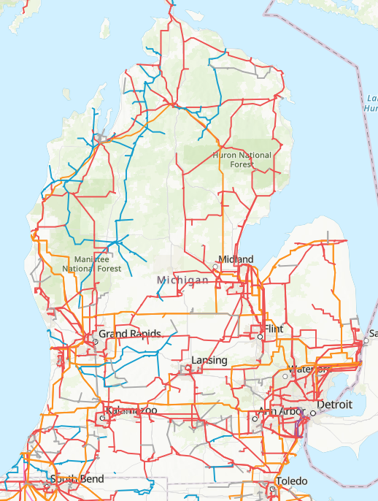
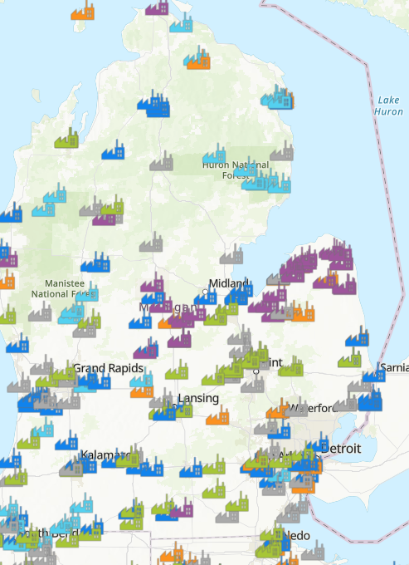
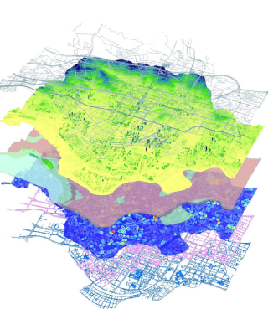
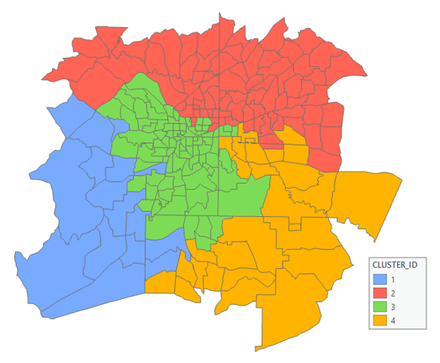
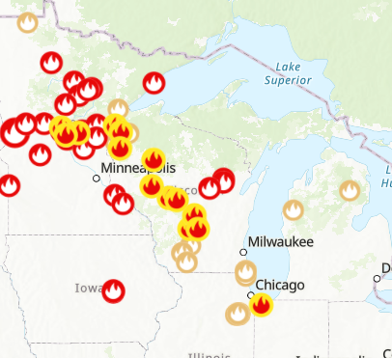
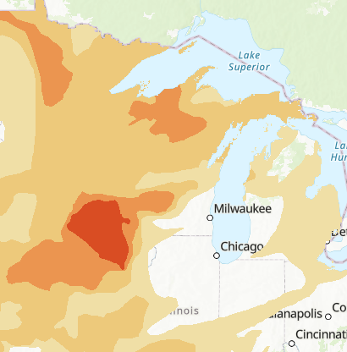
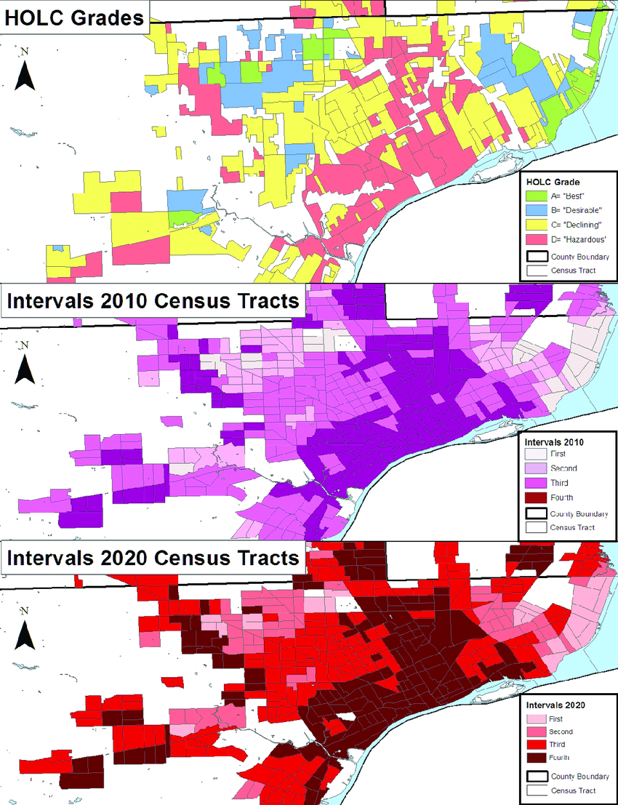
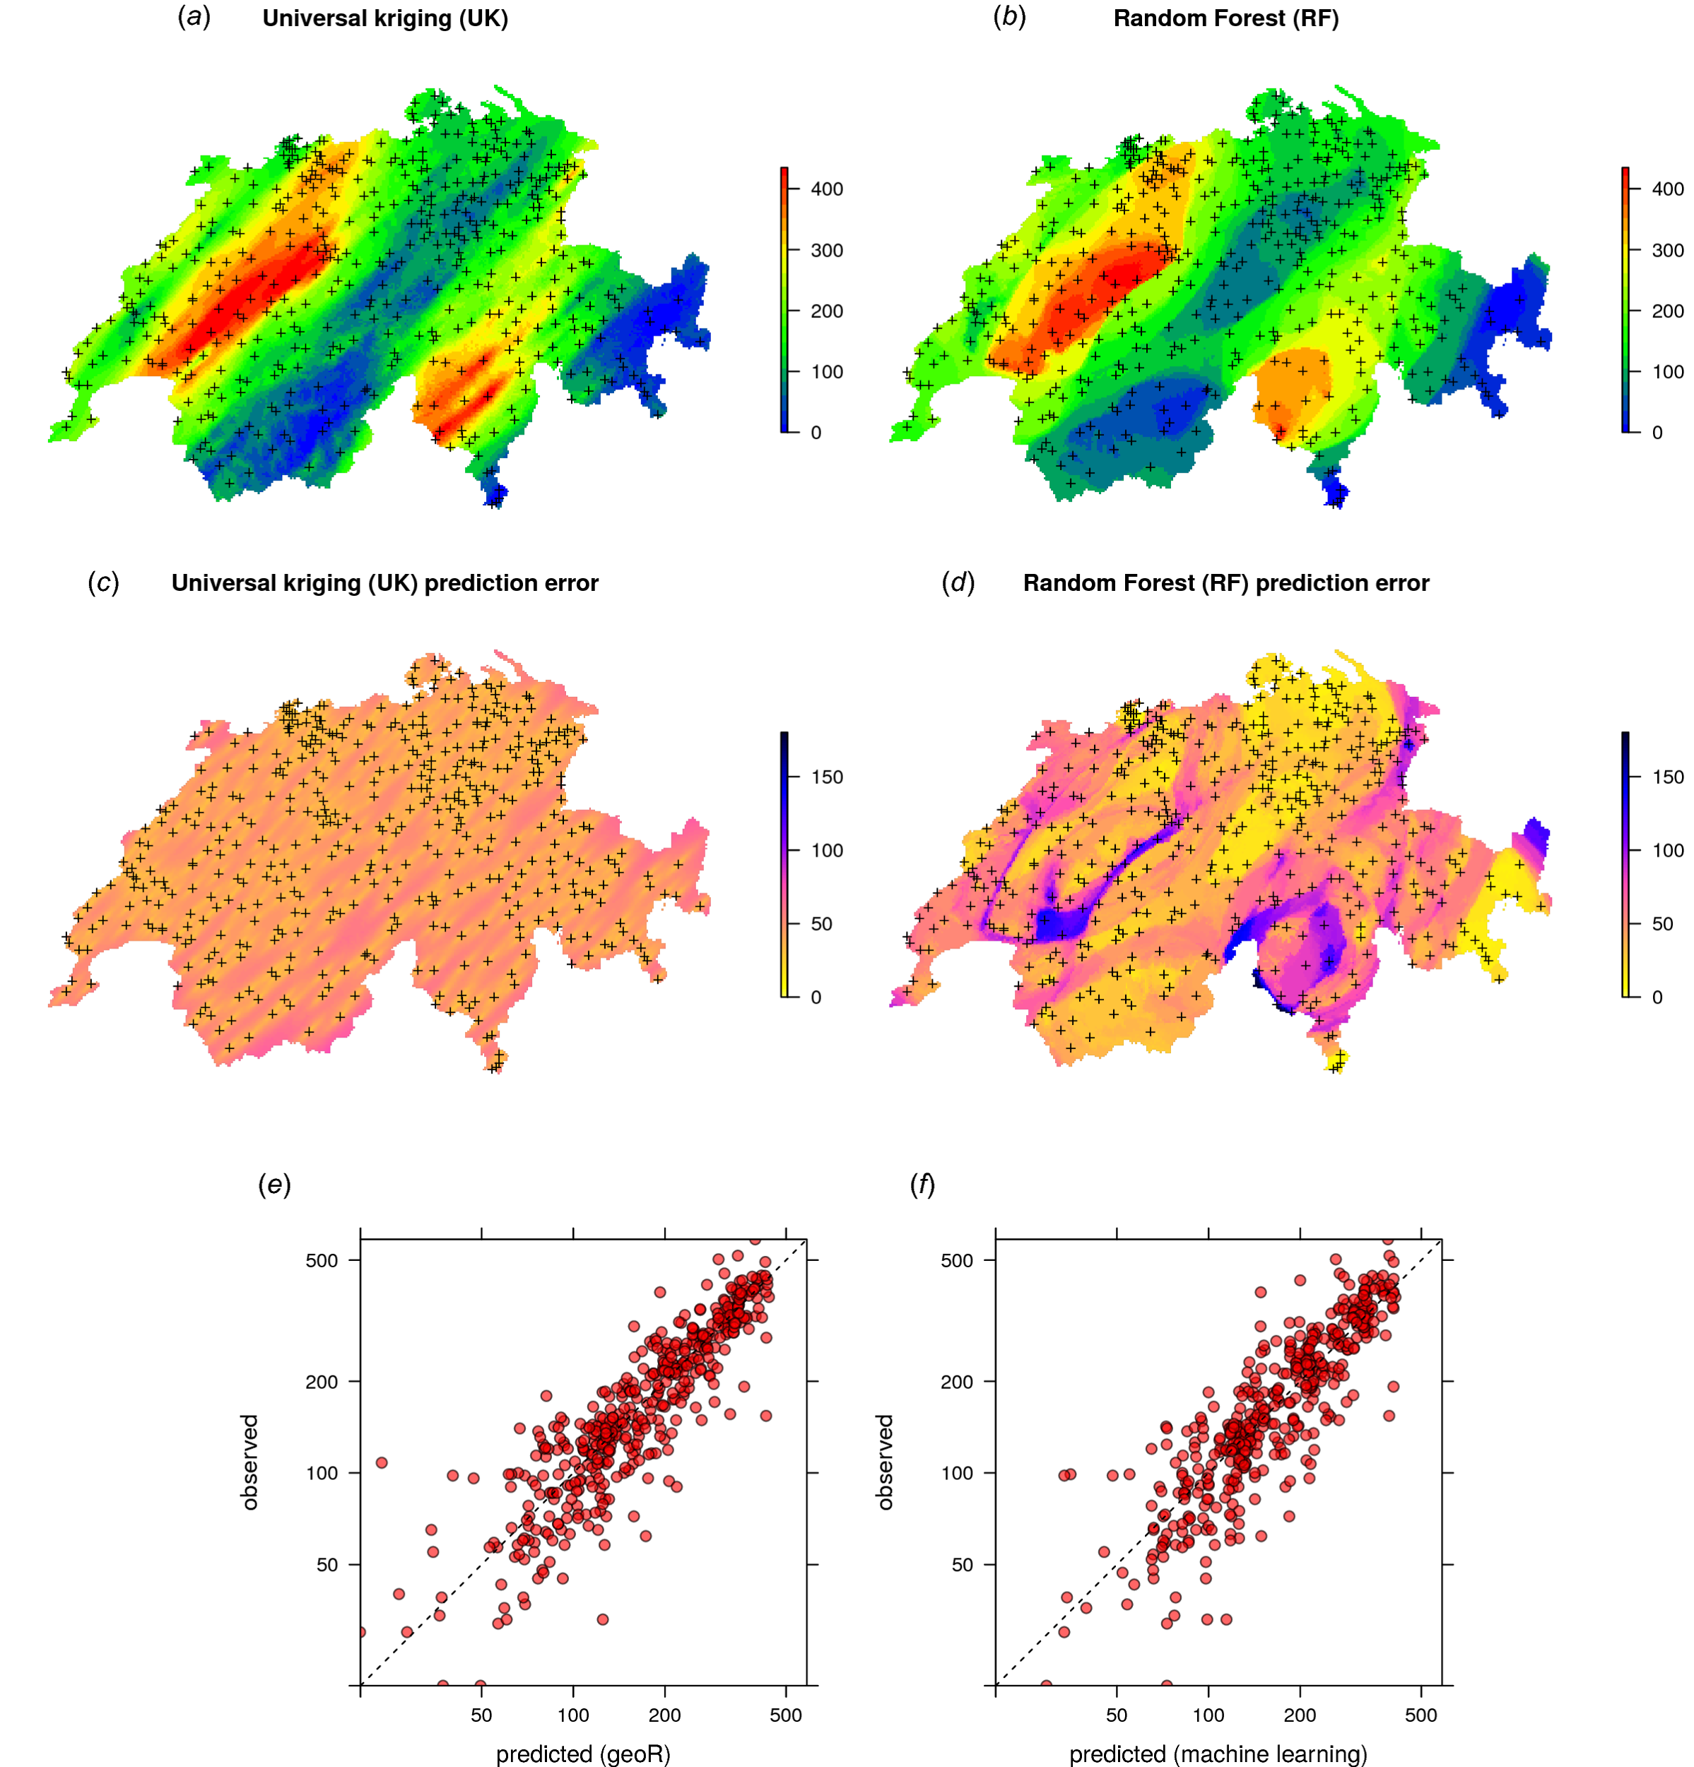
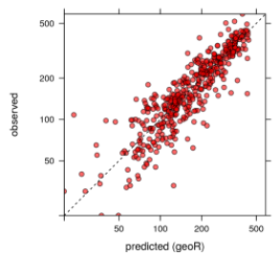
Multi-source data layers
Data analysis & interpretation
Clustering and prediction
Align data from different sources
New features show relationship between wildfires and power outages (e.g., distance from power lines to wildfire, vegetation density, historical wildfire frequency)
Grid Infrastructure
Power Plant Locations
Clustering:
Identify high-risk areas and offer prepared strategy
Assess risks of future power outages due to wildfires in different clusters
recommendations for policymakers
Building a multi-source data layer for a unified region
USA Current Wildfires
Drought Intensity
Administrative Forest Boundaries
Ignition Probability Coefficient
Weather and Climate Risk Coefficient
Prediction:
Wildfire risk index: likelihood of the risk of wildfire occurrence in different areas
Power outage risk score: likelihood of power outages in different regions
Economic loss estimations, etc.
DTE Historical Outage Data
Coefficient development
Wildfire Risk to Communities
Infrastructure Vulnerability Coefficient
Socio-Economic Impact Coefficient
Current Weather
Census Data
…
PSPS Effectiveness Coefficient
Notes:
Copy Slide Option #2

Slide 5
Software features/outcomes (1):
Designing interactive graphical user interface (GUI)
Based on data collection and analysis, we offer insights through data fusion, for example:
Ignition probability coefficient: Quantifies the likelihood of power system components (e.g., power lines, transformers) igniting a wildfire under various conditions. Factors could include the condition of the infrastructure, weather conditions (wind speed, humidity), and the presence of vegetation near power lines.
Weather and climate risk coefficient: Captures the influence of weather conditions (such as wind, temperature, and humidity) and long-term climate factors (like drought conditions) on wildfire risk. This could be used to predict high-risk periods for wildfires and power system vulnerabilities.
Infrastructure vulnerability coefficient: Measures the susceptibility of power system components to damage from wildfires, considering factors such as the age and design of infrastructure, materials used, and historical performance in past wildfire events.
Public safety power shutoff (PSPS) effectiveness coefficient: Assesses the effectiveness of preemptive power shutoffs in reducing wildfire risk, considering factors such as weather conditions, the condition and layout of the electrical grid, and the potential impact on communities.
Socio-economic impact coefficient: Evaluates the potential impact of wildfires and power system failures on communities, considering population density, economic activities, and critical infrastructure within vulnerable areas.
Notes:
Copy Slide Option #2

Slide 6
Software features/outcomes (2):
Clustering:
Clustering to analyze the relationship between power outages and wildfires using multiple spatial data sources involves identifying patterns and correlations between the occurrence of wildfires and the resulting power outages across different geographical locations. This analysis can help in identifying high-risk areas, improving preparedness, and designing mitigation strategies.
Use our developed tool to visualize the clusters on a map. This visualization can highlight geographic patterns in the relationship between wildfires and power outages.
Assess the risk of future power outages due to wildfires in different clusters. This assessment can inform infrastructure improvements, vegetation management, and emergency preparedness plans.
Develop strategies for high-risk areas, such as enhancing the resilience of the power grid, implementing more aggressive vegetation management practices, or planning for strategic power shutoffs during extreme fire danger conditions.
Provide recommendations for policymakers on improving regulations and standards for infrastructure protection in wildfire-prone areas.
Notes:
Copy Slide Option #2

Slide 7
Software features/outcomes (3):
Prediction:
Wildfire risk index, integrating in an alarm system, the index shows the likelihood of the risk of wildfire occurrence in different areas, considering current weather conditions, power infrastructure, drought status, vegetation (fuel load), and historical wildfire data. This index could be spatially resolved, providing a detailed risk map.
Power outage risk score: this score indicate the likelihood of power outages in different regions, integrating factors like the proximity to high-risk wildfire zones, the condition and age of grid infrastructure, and historical outage patterns. This could also include predicted outage durations, the potential number of affected customers, the estimated restoration time.
Infrastructure vulnerability assessment: this identifies portions of the electrical grid (including power plants and transmission lines) most vulnerable to disruption from wildfires, extreme weather, and other risk factors included in the model. This can guide preventive maintenance and grid hardening efforts.
Population impact projection: the potential impact on populations, considering factors such as the likelihood of power outages, the risk of wildfires, and demographic data from census sources. This could include estimates of the number of people at risk of evacuation, power loss, or other wildfire-related hazards.
Emergency response resource allocation: Guidance on the optimal allocation of emergency response resources (like firefighting crews and equipment, evacuation centers, and utility repair teams) based on the predicted intensity and locations of wildfires and power outages.
Economic loss estimations: Potential economic losses due to predicted wildfires and power outages
Notes:
Copy Slide Option #2

Slide 8
Overlay analysis: Overlay the different maps to identify areas where multiple layers of data overlap. It can be done using Geographic Information System (GIS) software, such as QGIS or ArcGIS. Overlaying the maps will allow the team to visualize the spatial relationships between various datasets.
Spatial join: Perform a spatial join operation in the GIS software to combine attribute data from multiple layers based on their spatial relationships. It will enable us to create a new data set with combined information from all the input layers.
Data aggregation: To analyze the data at different spatial scales, you may need to aggregate the data. For example, you could aggregate the data by census tracts, zip codes, or other administrative boundaries. It will help you explore patterns and relationships at various geographic levels.
Statistical analysis: Once the data is combined and aggregated, you can perform various statistical analyses to quantify the correlation between variables. Some standard statistical methods include (a) Spearman's rank correlation coefficient: This is a non-parametric measure of the strength and direction of the relationship between two variables. It is useful when the data does not meet the assumptions of linearity or normality required for Pearson's correlation. (b) Regression analysis: This helps you model the relationship between a dependent variable (e.g., power outages) and one or more independent variables (e.g., power grid infrastructure, redlining, renewable energy locations). We can use linear regression, logistic regression, or other regression models depending on the nature of your data.
Visualization: Create maps and charts to visualize the results of your analysis. It can help us identify spatial patterns and trends in the data and communicate our findings effectively.
Interpretation and validation: Interpret the results of your analysis, keeping in mind the limitations and assumptions of the statistical methods used. Assess the validity and reliability of your findings and consider conducting further research or incorporating additional data sources if necessary. For example, we will propose application-specific performance indicators, such as the Electricity Service Vulnerability Index.
Notes:
Copy Slide Option #2

Slide 9
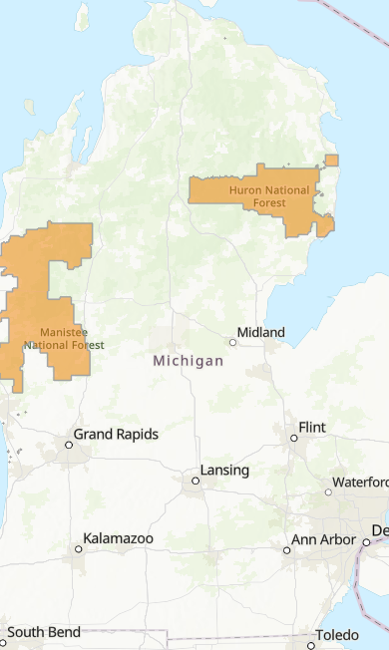
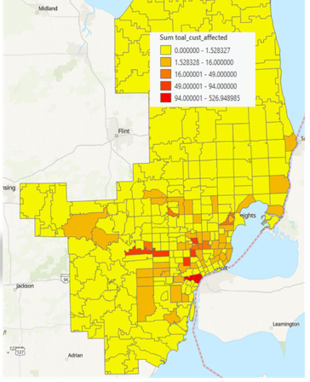
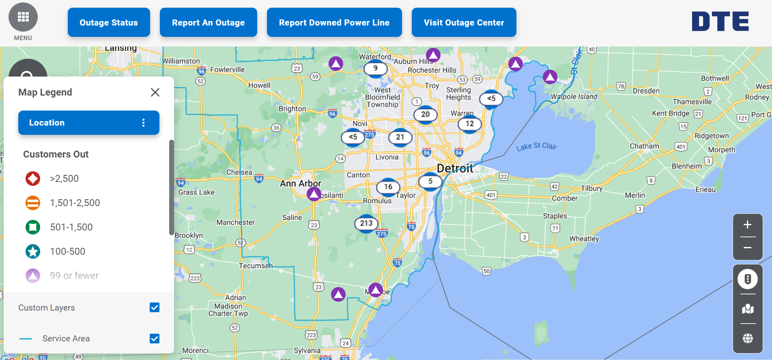
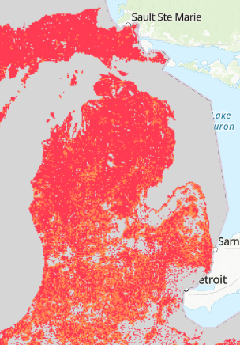
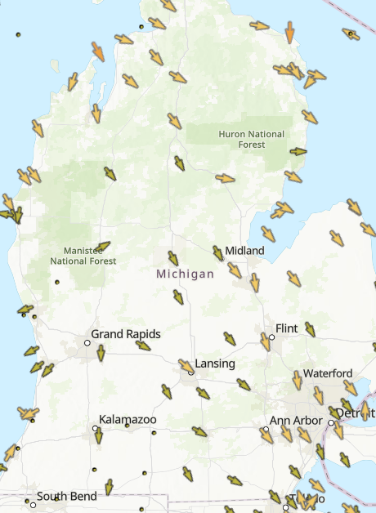
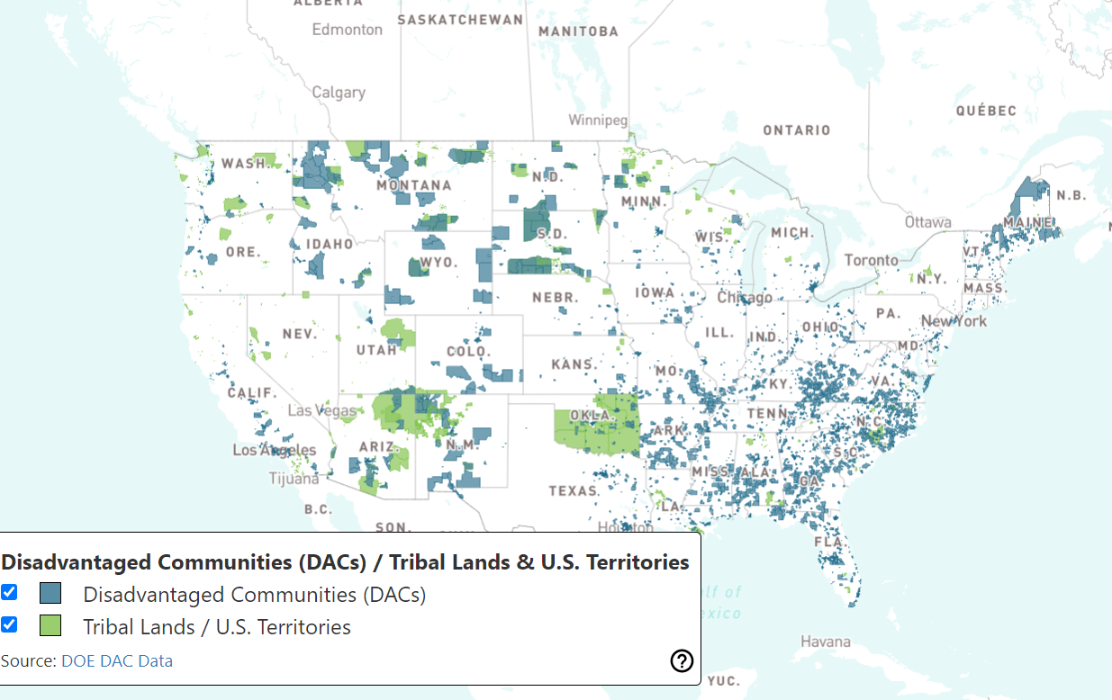
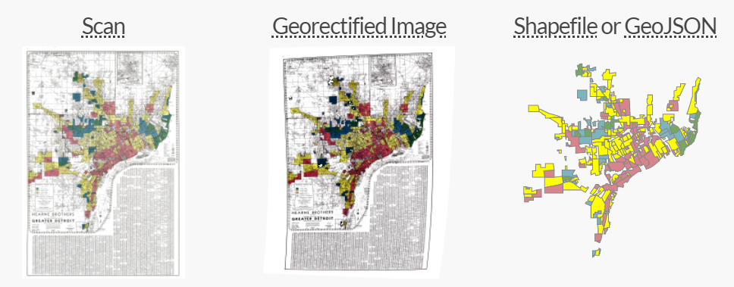
Grid Infrastructure
Power Plant Locations
Administrative Forest Boundaries
Census Data
Data Fusion
1
USA Current Wildfires
Drought Intensity
DTE Historical Outage Data and Prelim Analysis
Wildfire Risk to Communities Wildfire Exposure Type
Current Weather and Wind Station Data
Energy Justice Tools
Digital Redlining Maps
Notes:
Standard template for UM-Dearborn info. Adjust as needed based on your audience.

Slide 10
Thank you!
Notes:
Copy Slide Option #2

